Slide 1

Architectural Kata
2025

Slide 2

Agenda
01
Architectural Kata Introduction – 5 min.
02
Meet & Greet – 5 min.
03
Kata Topic – 20 min.
04
Clarifications – 10 min.
05
Kata Practice rooms – 2 hr.
06
Kata Presentation – 2 hr.
07
Retro – 10 min.
08
Winner and Runner-up announcement (offline)

Slide 3

Why Kata ???
"How do we get great designers? Great designers design, of course." Fred Brooks
"So how are we supposed to get great architects, if they only get the chance to architect fewer than a half-dozen times in their career?" Ted Neward
A 360-degree transformation framework that is aimed at improving the performance and culture of engineering by adopting best practices in Agile, design, development, and testing. It brings a shift left approaches & DevOps culture in our daily work-life. Our Engineering Excellence (EngX) practices, activities, and experts are there to guide EPAMers to learn and help achieve delivery excellence and time-to-value for our customers.
EngX Culture: When “Good Enough” is Not Enough

Slide 4
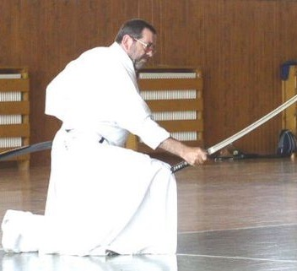
Kata
"Kata" is a Japanese word usually used in martial arts for practicing various patterns either alone or in smaller groups to memorize and attain perfection.

Slide 5

Kata
Architectural Katas are intended as a small-group (pizza teams i.e. 4-8 people) exercise, usually as part of a larger group (4-10 groups are ideal).
A Moderator keeps track of time, provide Kata and acts as the facilitator for the exercise.
The groups are given a kata (in many ways, an RFP–Request For Proposal) that needs a solution. The project team meets for a while, discovers requirements that aren’t in the original proposal by asking questions of the “customer” (the Moderator), discusses technology options that could work, and sketches out a rough vision of what the solution could look like.
Then, after they’ve discussed for a while, the project team must present their solution to the other project teams in the room, and answer challenges (in the form of hard-but-fair questions) from the other project teams.

Slide 6
Approach to build the best Kata
Understand the Problem!!
Ask Questions, Get the clarifications
Brainstorm with the team
Develop your solution and approach
Call out Assumptions
Present it as
a draw.io diagrams
images of you pen & pencil diagrams
Any other visualization tool
Use AI tools for solutioning (compliant - EPAM policies)
Not Expecting a Document
You get 15mins for the presentation + 5 mins for questions

Slide 7
Consideration
Actors Identification
Usecases - Scenarios/Functional understanding
Views
Component view
Deployment view
Flow/Activity diagrams
Application Architecture
Data Architecture
Technology Architecture
Inscope/Outscope and RAID
Risks, Assumptions, Issues and Dependencies
NFRs and DR
Performance, Portability, Scalability, Capacity, Security, Availability.
Good to list ASR
Data compliance rules and policies
Technology Stack (optional)
Solution Practicality

Slide 8



Problem Statement

Slide 9
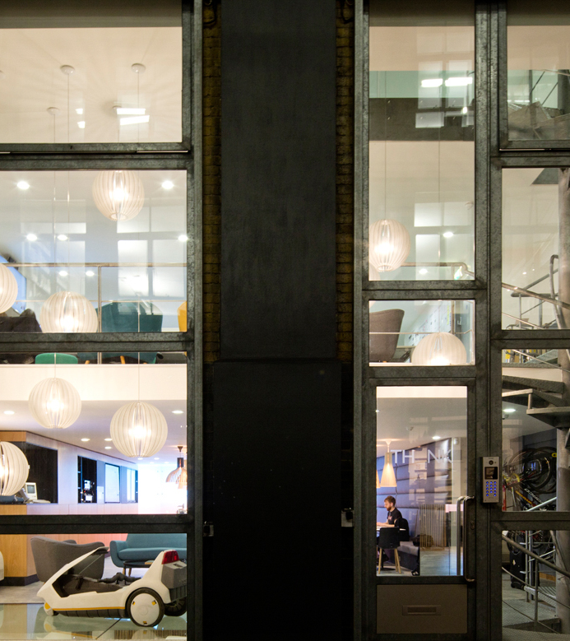
Digital Payments
Kata Topic
We are a startup Company seeking an application that can facilitate smooth monetary transactions between payers and recipients. Recipients can be individuals or Merchants. We want the application to be integrated with multiple third-party services like loyalty management, omnichannel communication and more.

Slide 10
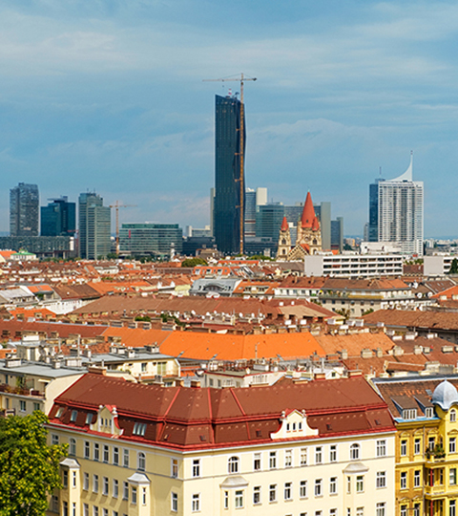
Context
We want to capture the market to provide the necessary digital payment services
Initially start in full scale in a country.
Forecast significant growth in transactions at the beginning of the next year and it will increase every year.
As this payment service Security, Compliance and Availability is very important
Banking sector is booming sector, and many new projects are launched to cater digital payments and financial services.

Slide 11
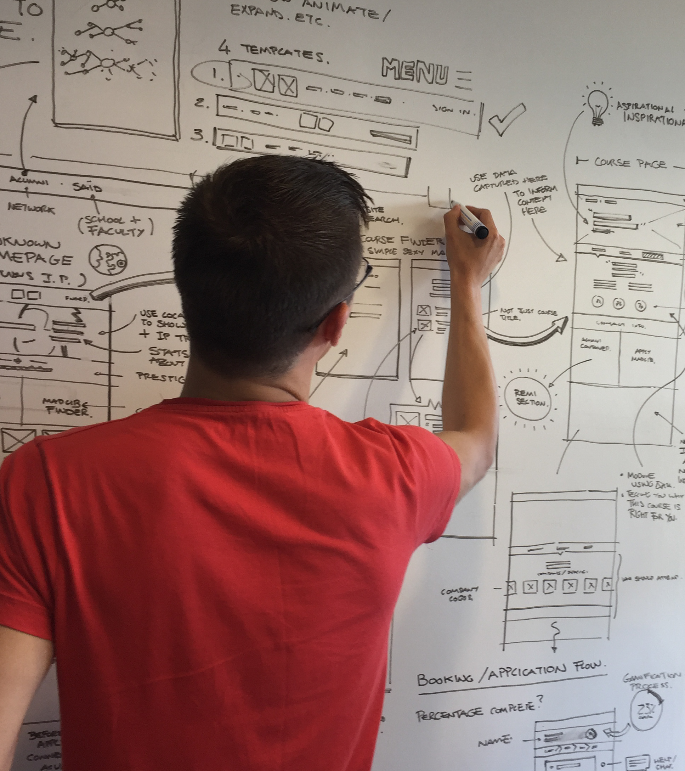
Requirements
Customers will register through the app, where they must enter their name, phone number, and IBAN(Banking account number) number.
Merchant mgmt. is to be done by authorized personal
Application must work with digital banks, wallets and point of sale systems.
Payments in the application will be facilitated through integration with various banking services.
Payment to be done with or without a QR code.
User should be able to scan and download QR code for payments.
Customers should be able to look up transactions from the previous five years.
Customers should receive communications through a variety of channels of the transaction details.
Email can be used to exchange transaction history via receipts.
It ought to be possible for us to assign a service rating to merchants.

Slide 12
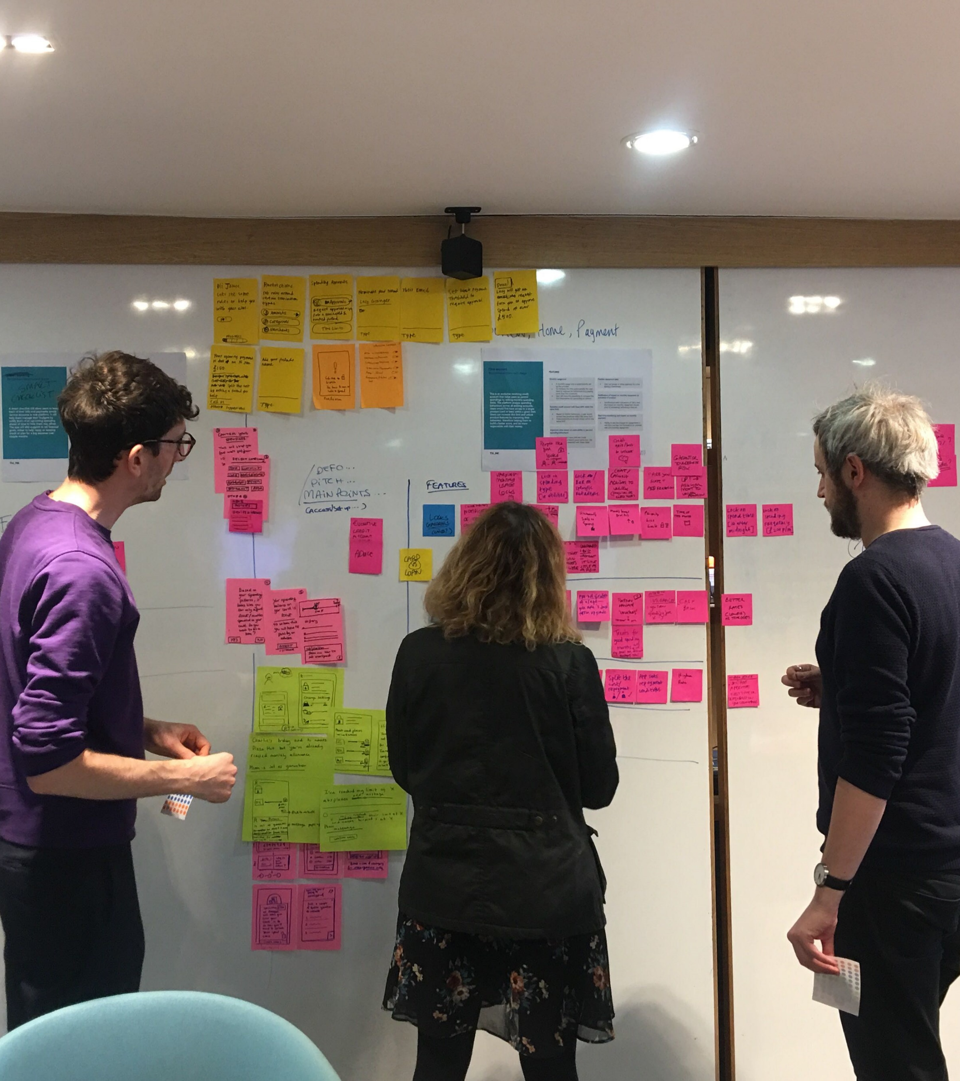
Requirements
Fraud detection management plays a crucial role for app.
Cost is a crucial consideration up until the point at which study income is generated.
We welcome both cloud-based and off-cloud solutions.
Nice to have:
The chat box for the help should open.
Loyalty program implies acquiring coins/points by performing various activities by app users. Users can then use accumulated coins/points during the payment process. Each registered user is automatically registered in the loyalty program.
Three loyalty tiers are available to application users: Silver, Gold, and Platinum.
Cashback management allows admin users to view and manage the amount of cashbacks that application users receive when they use certain types of Bank cards.

Slide 13
Thank you!

